Slide 1
Neural Networks for Image Classification
Project area – massive algorithmics

Slide 2
Contents
Introduction
Objectives and Data
Data Visualization and Transformation
Classification Using Neural Networks
Neural Networks
Architectures and Analysis
Demo of working prototype

Slide 3
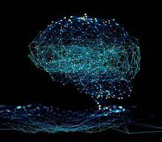
Introduction
Massive Algorithmics
Deep Learning
Classification

Slide 4
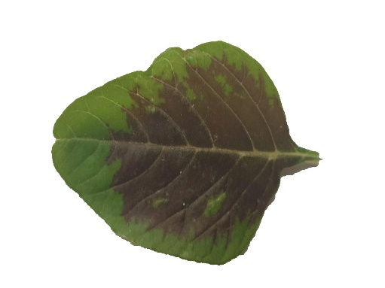
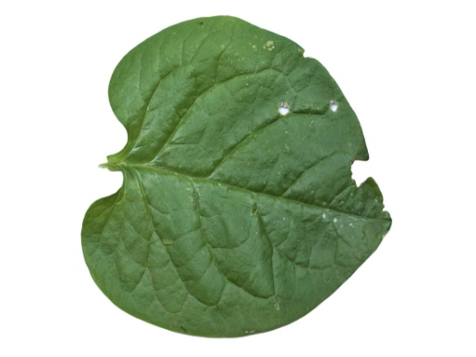
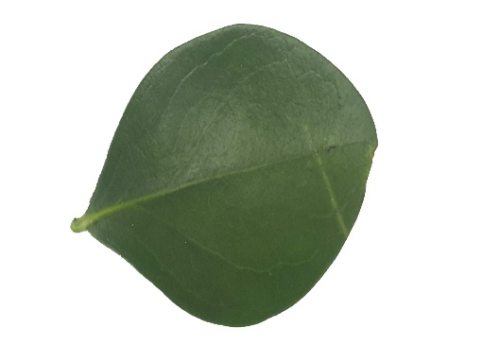
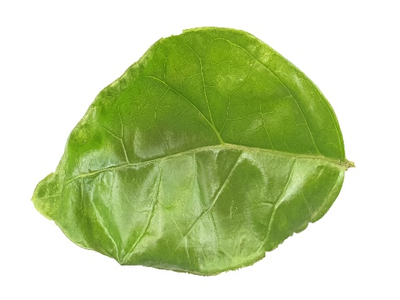
Objectives and Data
Multiclass classification of Images using Neural Networks
Data: https://data.mendeley.com/datasets/nnytj2v3n5/1
Data consists of Images Medicinal Leaves
Arive-Dantu
Basale
Karanda
Mint

Slide 5
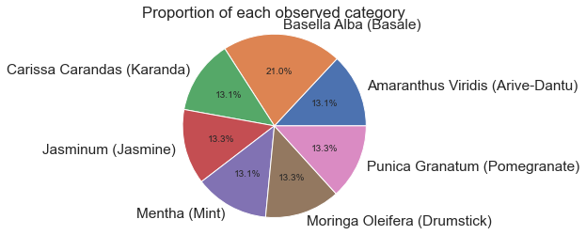
Dataset Visualization

Slide 6
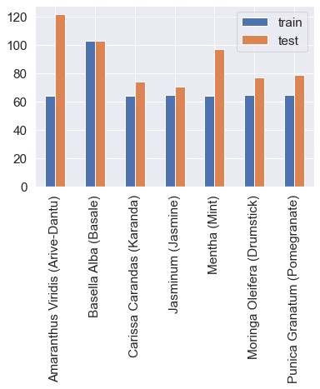
Dataset Visualization

Slide 7
Data Transformation
Size Transformation
150x150
Colour Transformation
BGR to RGB
Pixel Value Transformation
1 to 255 scaled down to 0 to 1

Slide 8
Convolutional Neural Networks
Used for Classification
Layers and Hyperparameters –
Convolutional Layer
Pooling Layer
Fully Connected Layer
Dropout
Activation Functions
Loss Functions and Optimizers

Slide 9
Architectures
Custom
Layer 1: Convolutional Layer
Layer 2: Maxpooling Layer
Layer 3: Convolutional Layer
Layer 4: Maxpooling Layer
Layer 5: Flattening Layer
Layer 6: Dense Layer
Layer 7: Output Layer

Slide 10
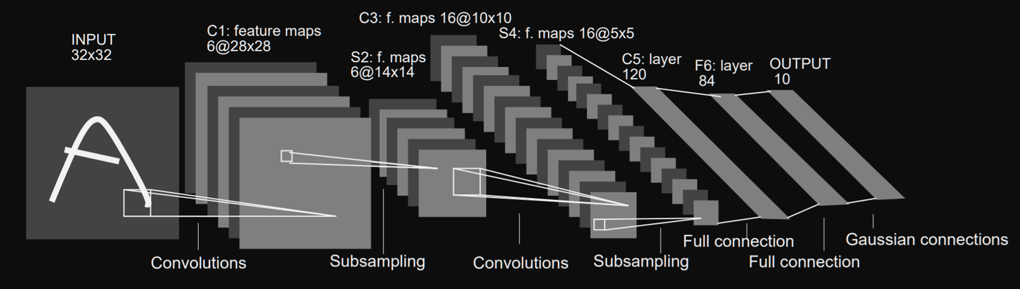
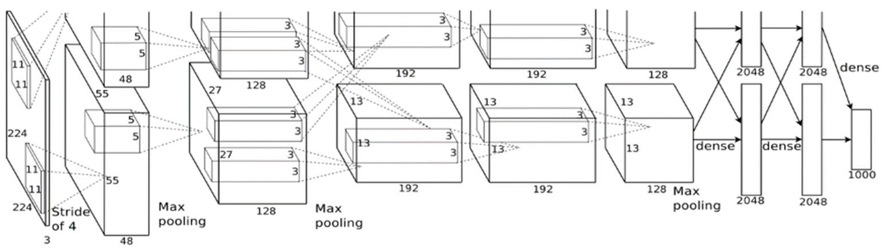
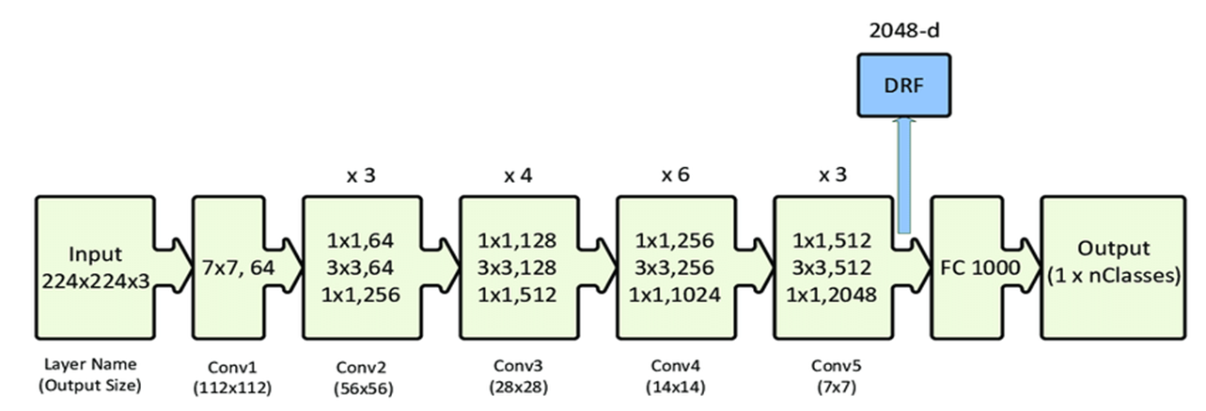
Architectures
Lenet-5: 5 Layers
AlexNet: 8 Layers
ResNet-50: 50 Layers

Slide 11
Analysis

Slide 12
DEMO

